Slide 1

SOCIAL & RELIGIOUS REFORM MOVEMENTS IN INDIA
19th and 20th centuries
GE- 1:HIST (A) 310
B.A.PART- III (H.P.U.)

Slide 2
Chapter 1
BACKGROUND AND CAUSES
OF REFORM MOVEMENT

Slide 3
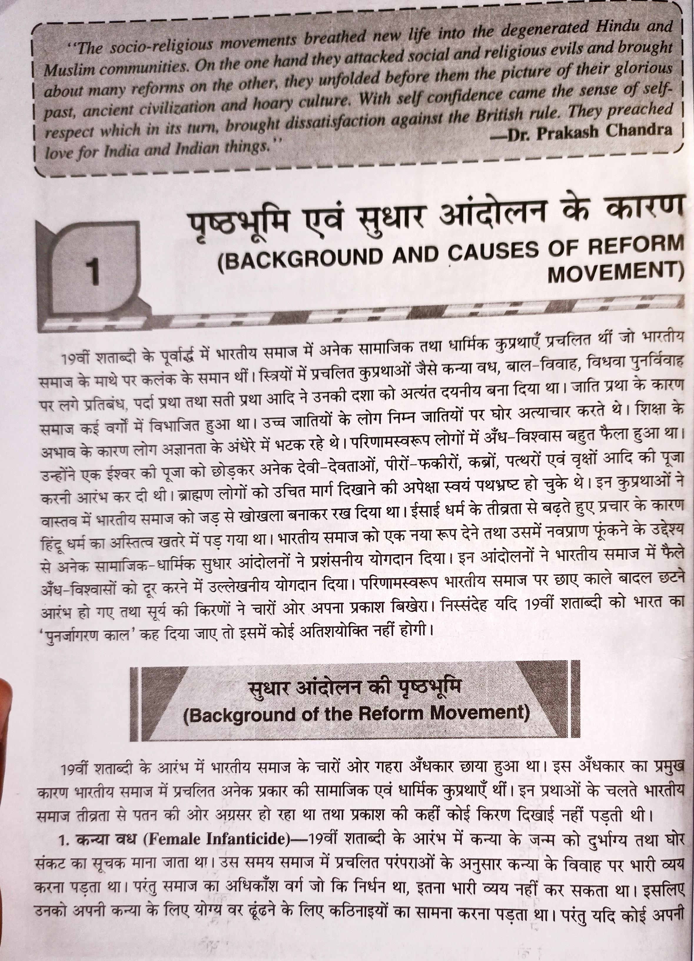

Slide 4
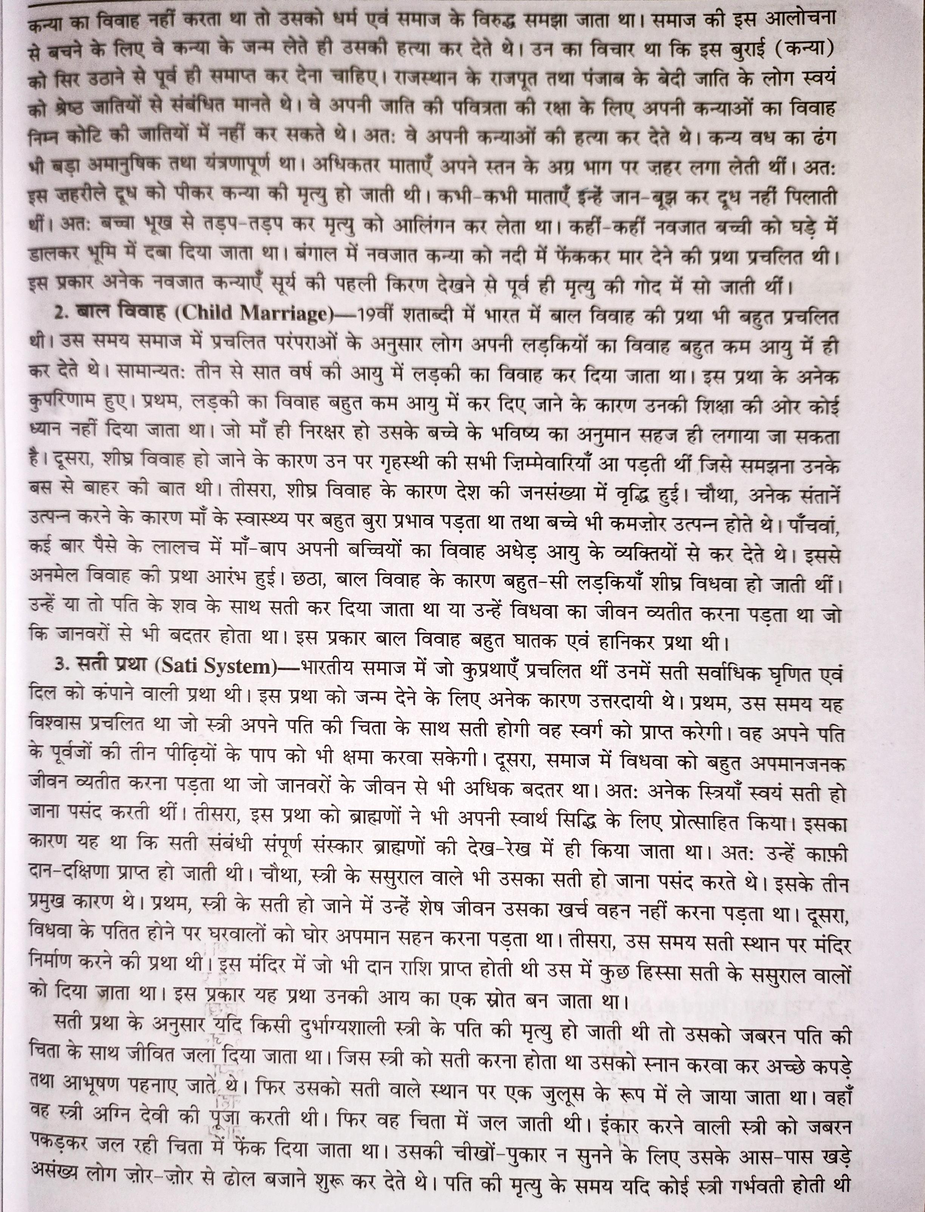

Slide 5
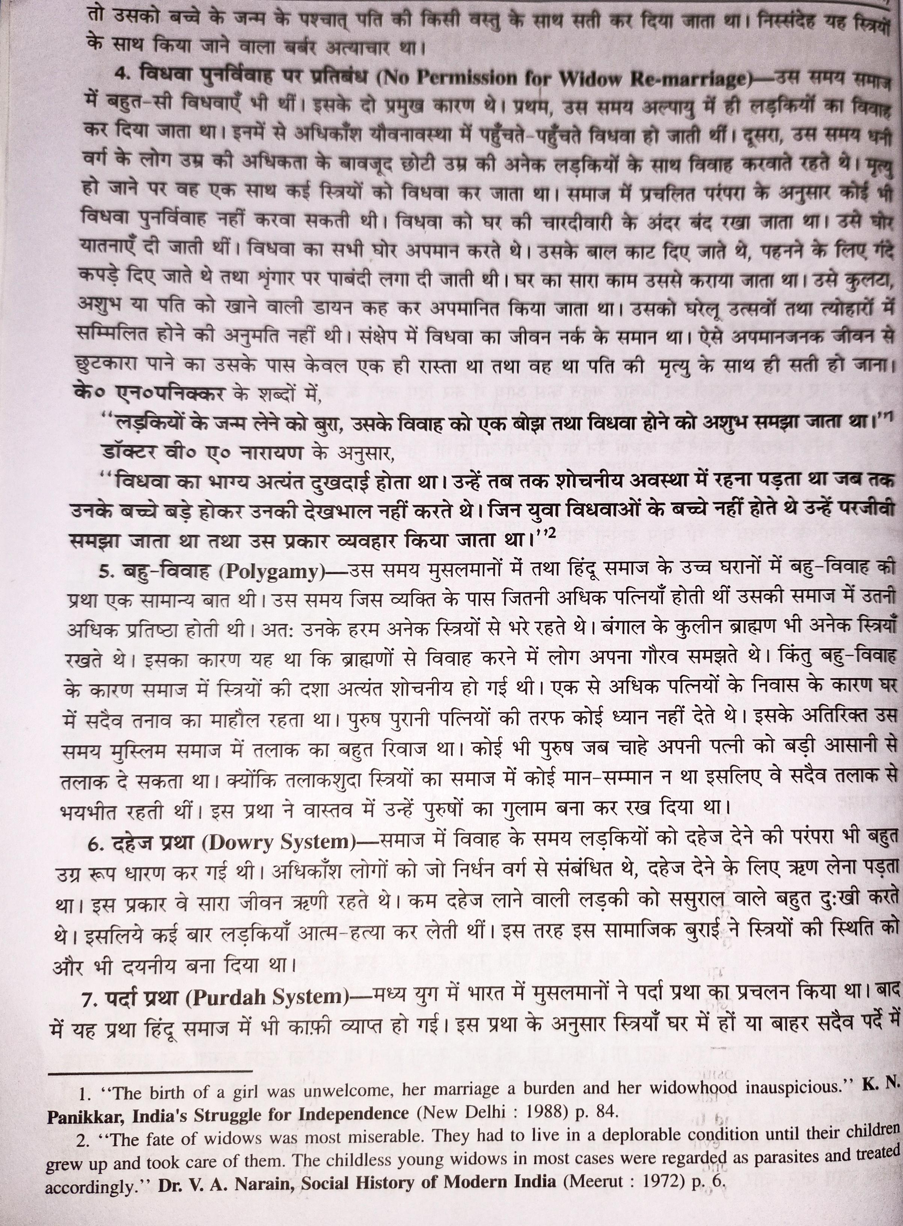

Slide 6
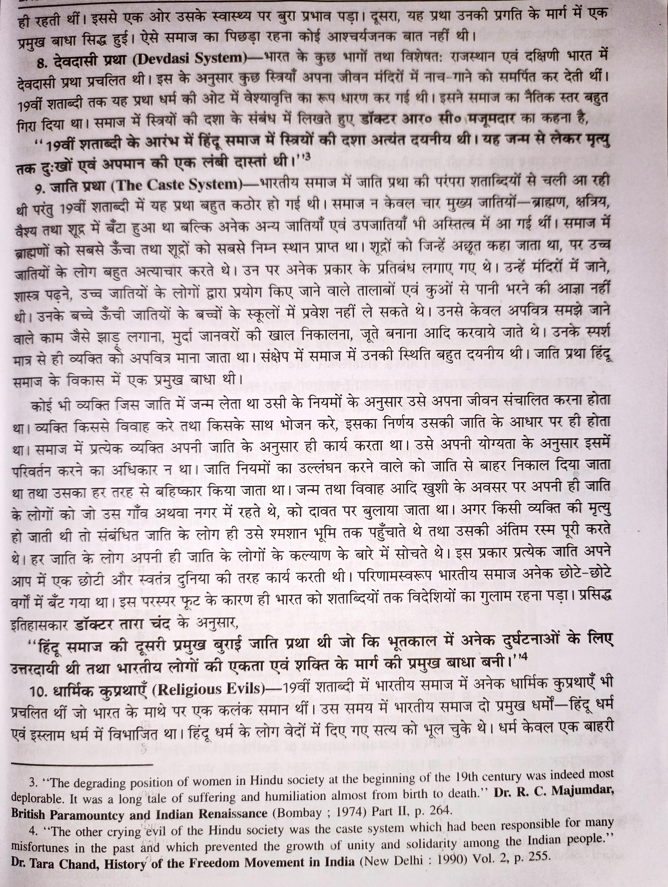

Slide 7
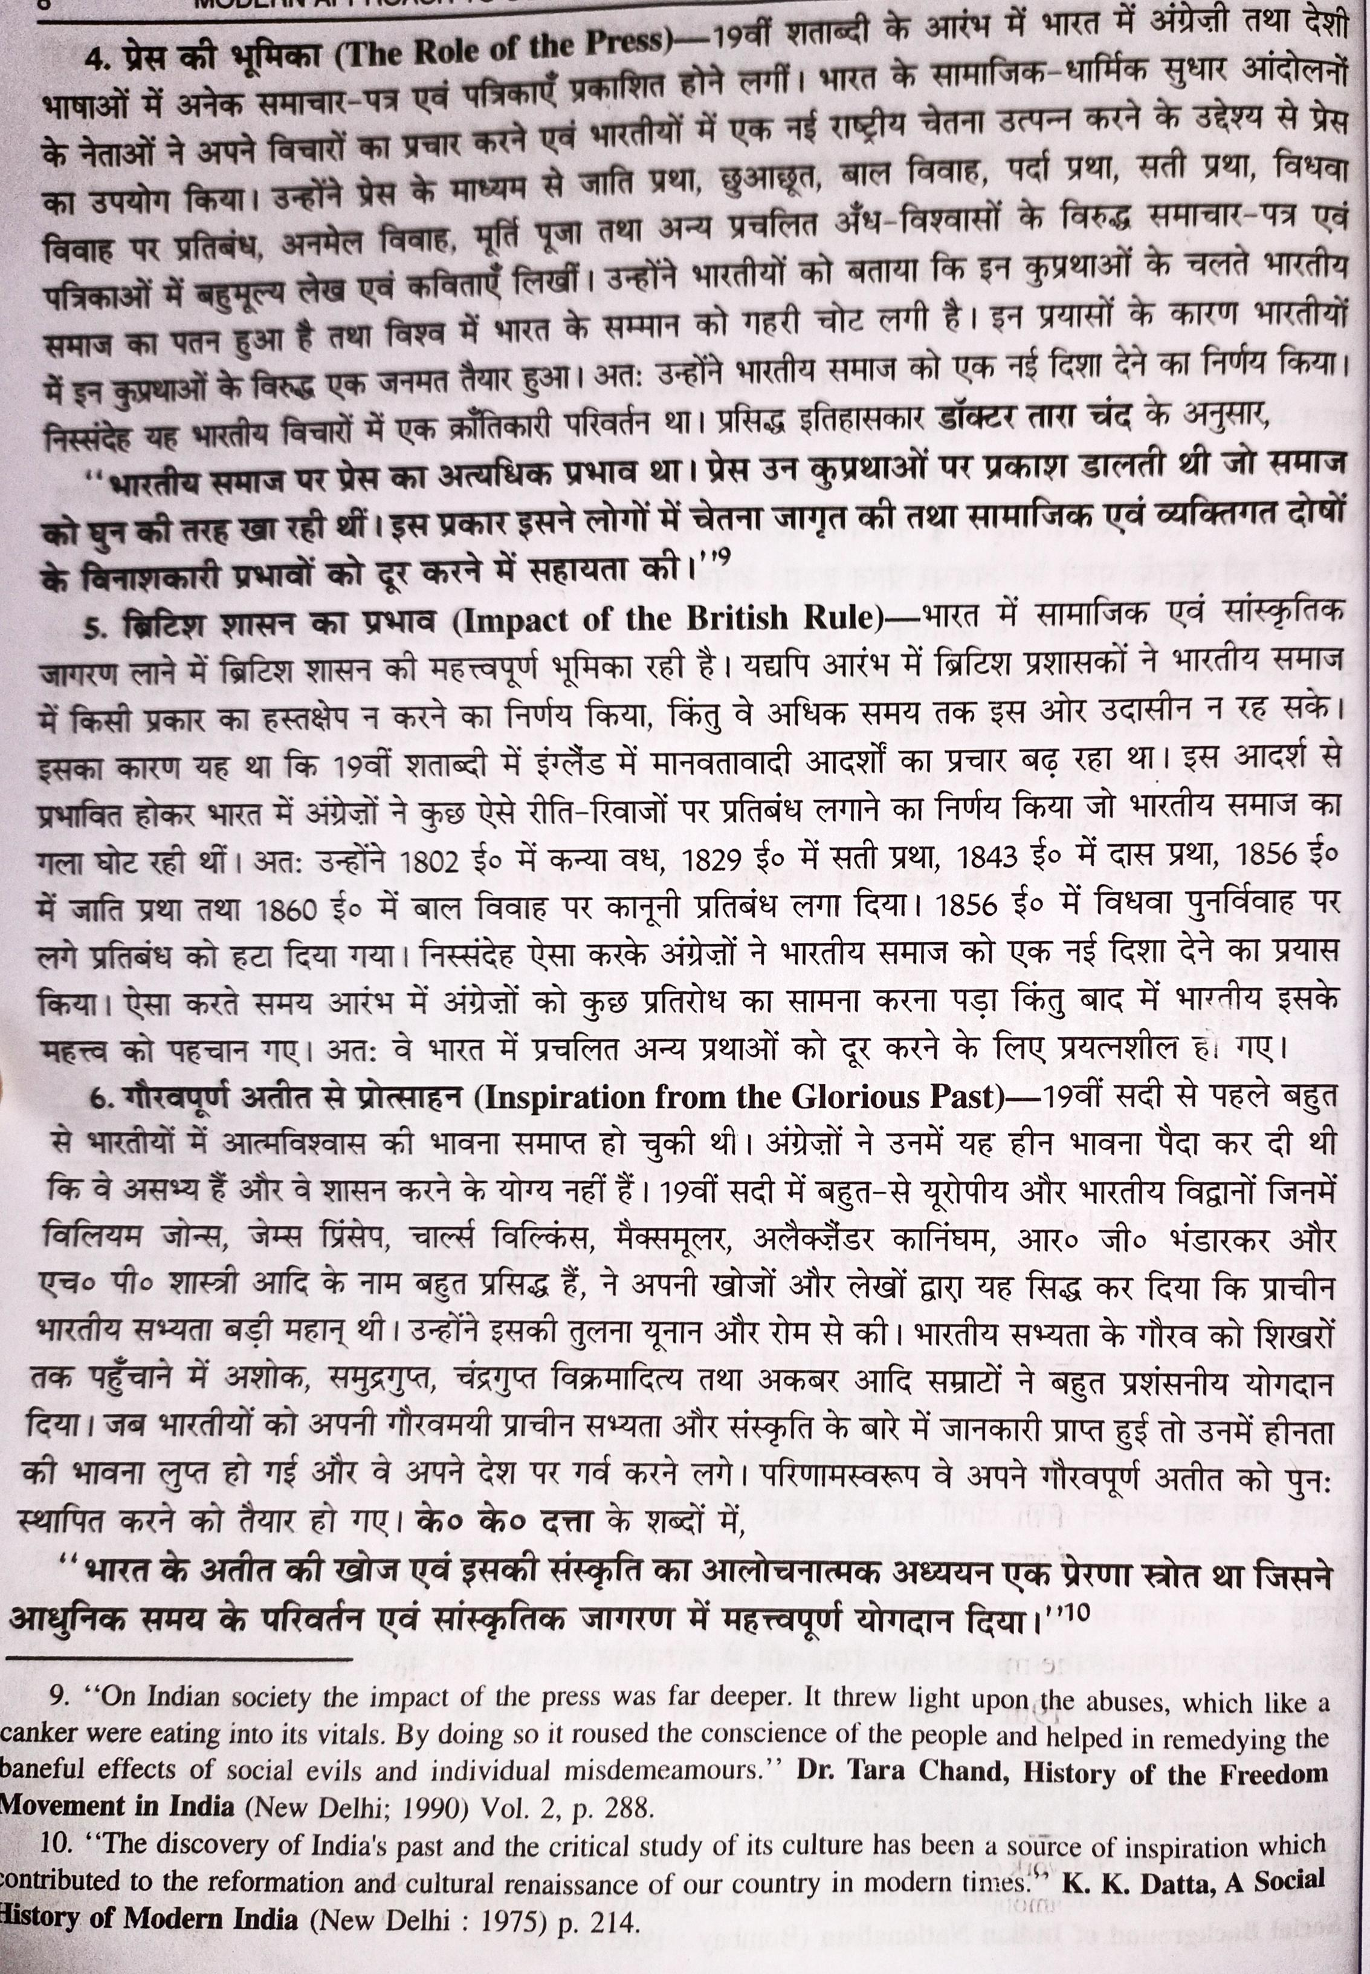

Slide 8
